Slide 1

RDBMS MINI PROJECT
CG – Café
Presented By – Team 1

Slide 2
Team – 1 Team Members
1. SHASHANK KUMAR (Team lead) – 160746
2. NEERAJ KUMAR SINGH – 160689
3. ASHMITA KARWASRA – 160567
4. BHAVESH GUPTA – 160568
5. KSHITIJ KUMAR AGARWAL - 160652

Slide 3
TABLE OF CONTENTS
Objective
Abstract
Requirements
Working of the project
Design
Screenshot
Testing
Advantages
Summary

Slide 4
OBJECTIVE
To Design a database, developing the queries and basic reports for the workplace Cafeteria.

Slide 5
ABSTRACT
This database contains Vendors details, Items list and gives the billing details of the employee based on the orders placed.
User will get the option to choose the Meal time and the rest of the details will be displayed like available Vendors, their menu accordingly.

Slide 6
Requirements
Employee Details Table (EMP_ID,EMP_NAME)
Vendors Table (VEN_ID,VEN_NAME,MEAL_TIME)
Menu Table (ITEM_ID, ITEM_NAME,VEN_ID,MEAL_TIME,ITEM_PRICE)
Bill Table (I_ID, I_NAME, I_PRICE, I_QTY)
The new user will have to register and then Login to access CG – Café.
The Vendors List and their menu should be displayed according to the meal timing (Breakfast, Lunch, Snacks).
Bill will be displayed according to the order placed by the User.

Slide 7
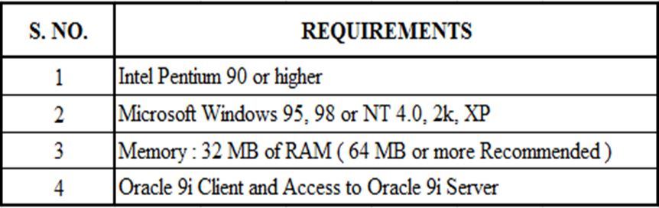
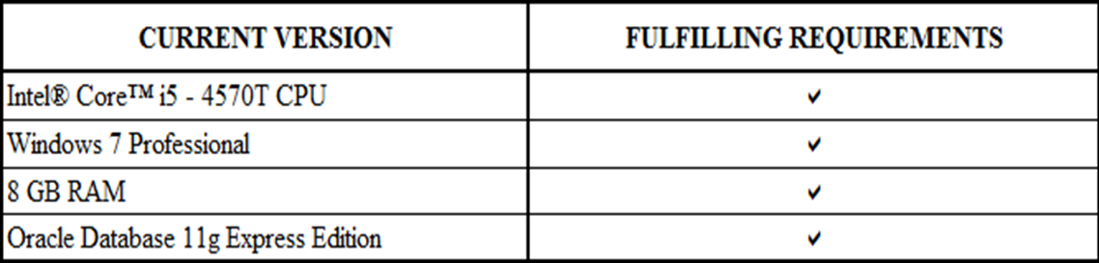
Hardware and Software Requirements

Slide 8
Working of the project
In this C-café project, the user have to enter the employee id and password if it matches user can proceed further to ordering items.
1
After login, user can choose options among breakfast, lunch and Snacks.
2
Then the options among available vendors are displayed.
3
After choosing a particular vendor, list of menu items will be displayed.
4
Upon selecting the required food item and quantity, the C-café system will display the bill amount.
5

Slide 9
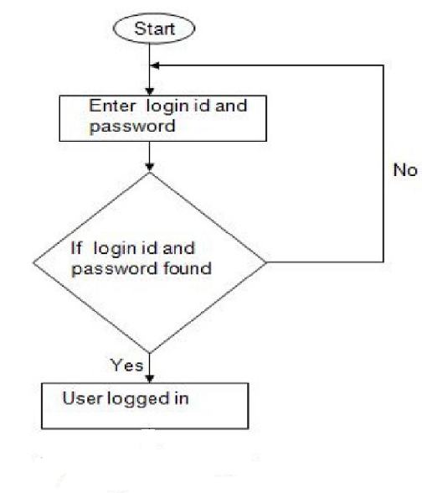
Design
Data Flow Diagram

Slide 10
UML Diagram

Slide 11
Table Used (Employee, Vendor, Items, Bill)
Emp_id | Emp_name
Ven_id | Ven_name | Meal_id
Item_id | Ven_id | Item_name | Time_id | Item_price
i_id | i_name | i_price | qty

Slide 12
Screenshots

Slide 13
Testing

Slide 14
Advantages
User gets option of ordering from more than one vendor at a time.
Reduces real time traffic as its fast then normal ordering system.

Slide 15
Summary
A Database system for CG – Café is designed for ordering food from various vendors, calculating bills etc.
Various functionalities which are used to develop this database system are as follows:
Creating tables for storing data
Inserting real time data into tables
Displays list of Vendors available during various meal timings(breakfast, lunch, snacks)
Give details of the availability status of item along with vendor name and item price
Procedures and Functions used to accept the user requirement of food items and given the calculated bill.

Slide 16
Thank You :)

